Slide 1

NIGERIA COVID 19 DATA ANALYSIS USING PYTHON

Slide 2
PROJECT OVERVIEW
1
The effect of Covid 19 Pandemic on Nigerian States

Slide 3
Covid 19 is an infectious disease caused by Coronavirus, It is known to have affected may parts of the world, Nigeria inclusive. Nigeria recorded her first case on 27th February 2020. Nigeria has 36 states and the federal capital territory with over 200 million citizens. This project applies data analytics and data science tools to perform analysis and generate insights on the effect of Covid 19 on Nigeria and Nigerians.

Slide 4
DATA OVERVIEW
2

Slide 5
DATA CATEGORIES
Three categories of data were used:
NCDC data scraped from the COVID 19 website
Global dataset from John Hopkins Repo
External Datasets

Slide 6
METHODS
The Global Datasets from the John Hopkins Repository consist of:
Global Daily Confirmed Cases
Global Daily Recovered Cases
Global Daily Death Cases

Slide 7
METHODS
The https://covid19.ncdc.gov.ng/ website was scrapped using Web scraping python libraries (Request, Urllib, Beautiful Soup)
The table on the website was extracted and converted into a .csv format which was then named NCDC.csv. The data stored in csv was cleaned.

Slide 8
ANALYSIS
3

Slide 9
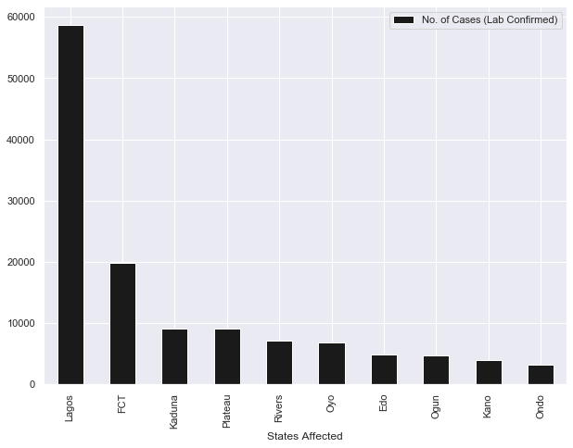
Infection Rate
The ten states with the highest infection rates 👉
From this chart we can see that Lagos is the epicenter of the pandemic followed by FCT, Kaduna and others.

Slide 10
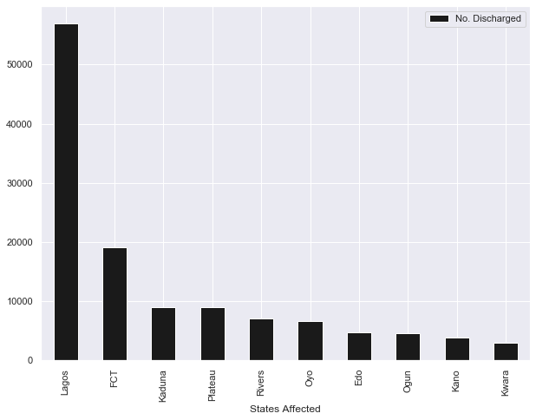
Recovery Rate
The ten states with the highest recovery rates 👉
From this chart we can see that although, the state with the 10th highest infection rate is Ondo, the 10th highest for recovery here is Kwara.

Slide 11
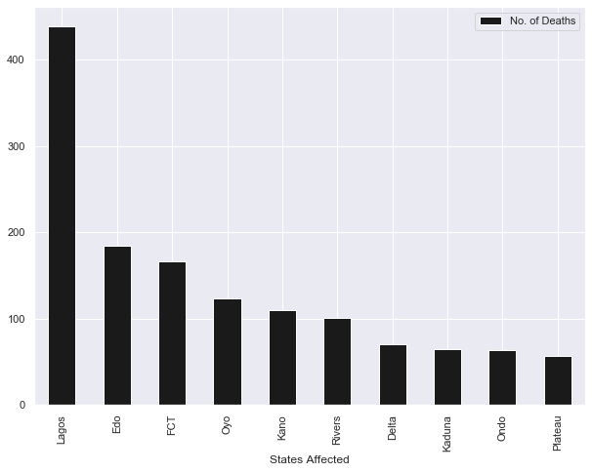
Mortality Rate
The ten states with the highest mortality rates 👉
Notice that although FCT is the 2nd for infection rate, it is the third for mortality. Edo is the 6th for infection but the 2nd for mortality.

Slide 12
Deductions
Lagos has the highest infection, mortality and recovery rates, hence it is the epicenter of the pandemic
FCT is the 2nd highest in terms of infection rate and recovery rate but 3rd highest in terms of mortality rate, which means they are handling the pandemic quite well.
Edo and Plateau need a better health care system to tackle the virus because Edo is the 6th in terms of Infection but the 2nd in Mortality. Plateau is not among the top 10 with high infection rate but it is the 10th highest in terms of mortality.

Slide 13
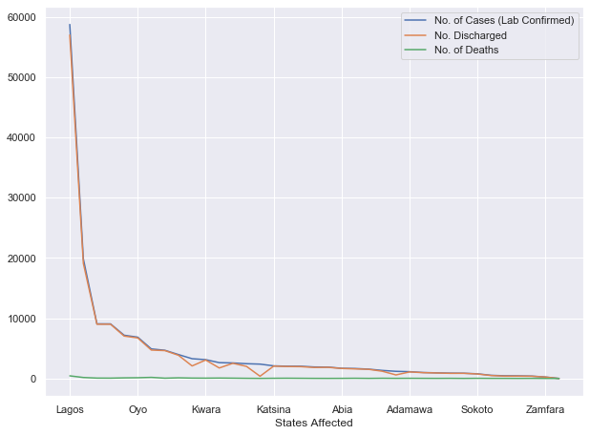
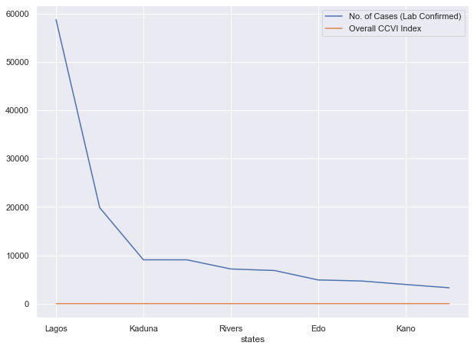
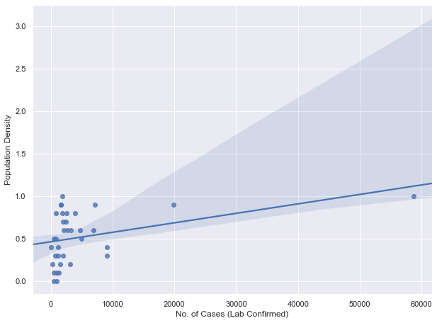
Line Plot showing the Infection Recovery and the Overall CCVI Index
Line Plot showing the Infection Recovery and Death rates.
Relationship between infection rate and population density

Slide 14
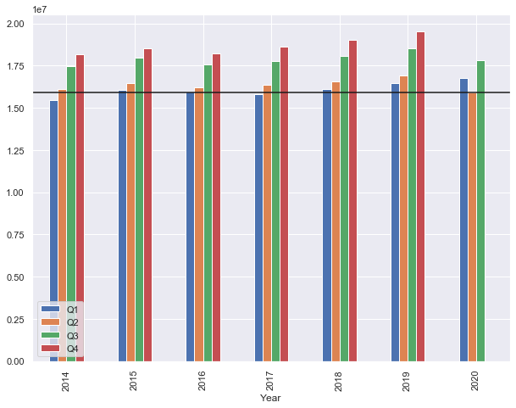
Effect on GDP
The GDP of Nigeria for 7 years (Q1 –Q4).
Based on the chart 👉
It can be observed that the 2nd Quarter GDP of 2020 is the lowest for the past seven years due to the effect of the Pandemic

Slide 15
CONCLUSION
4

Slide 16
Conclusion
This analysis shows the effect of the Covid 19 Pandemic on Nigeria’s GDP, Budget and the most affected staes.
In addition, the relationship between Inflection rate and population density.
Based on this analysis, we can also deduce the states with the best facilities to tackle a pandemic and the states lacking.

Slide 17
Credits
Presentation template by Slides Carnival
Photographs by Unsplash
How to write a Professional Summary Ustacky
COVID 19 Data by John Hopkins Repository
COVID 19 Data from https://covid19.ncdc.gov.ng/

Slide 18
THANKS!

Slide 19
Con
The pandemic year had a great effect on all countries of the World, Nigeria inclusive. The most intensified part of the Pandemic in Nigeria was the 2nd Quarter of 2020. Based on this project, we have been able to discuss:
The effect of the pandemic on GDP
The relationship between the Infection Rate and the Population Density
The states most affected by the Pandemic: Infection, Death and Recovery Rates

